Slide 1


Slide 2
Background

Slide 3


Introducing the Valkey project
Fully compatible with Redis OSS 7.2
Vendor Neutral
BSD-3 Licensed
Built by contributors in the open source community
Notes:
Three key points about Valkey:
1. It’s fully compatible with Redis OSS 7.2, and will always be.
2. It’s backed by the linux foundation, so it will remain open-source and vendor neutral.
3. It has a diverse backing. There are six technical steering members, from six different companies.

Slide 4












Backed by industry leaders

Slide 5
The Valkey project is thriving
50+ corporate supporters of the project
225+ code contributors to Valkey engine
60+ code contributors to clients and supporting libraries
1500+ pull requests across all projects since launch
100M+ container pulls
10+ managed Valkey providers
Notes:
Valkey is a thriving project, highlight the corporate support, number of commits, and how it's being widely adopted.
Limited managed provider list: AWS, Aiven, GCP, Elastio, OCI, Yandex, Upcloud, Netapp instaclustr, Percona, Exoscale, stackhero

Slide 6
Latest developments in Valkey OSS
September 16
2024
October 21
2025
Valkey 8.0
Release
Valkey 8.1
Release
Valkey 9.0
Release
April 2
2025
Notes:
Valkey's releases have been on a roughly 6 month cadence. Valkey 9.0 shipped in October 2025 and 9.1 shipped in May 2026.
Valkey 9.0 was a major release with atomic slot migration, hash field expiration, numbered databases in cluster mode, and 1 billion+ RPS clusters.

Slide 7
Valkey 7.2 (April 2024)
First stable Valkey release, forked from Redis 7.2
100% API compatible with Redis OSS 7.2
Community governance under the Linux Foundation
ACL improvements and security hardening
Foundation for all future Valkey development
Source: valkey.io/blog/valkey-7-2-5-out/

Slide 8
Valkey 8.0 (September 2024)
3x throughput with multi-threaded I/O
25%+ memory reduction with embedded hashtable entries
1M+ RPS on a single node
Dual-channel replication for faster failovers
Improved cluster bus reliability
Enhanced observability with per-slot metrics
Source: valkey.io/blog/valkey-8-0-ga/

Slide 9
Valkey 8.1 (April 2025)
20%+ memory reduction with new hash table
300%+ faster TLS via offloaded negotiations
90%+ P100 latency reduction with new defrag algorithm
Improved full-sync with prefetching iterator
Conditional updates built into SET command
New latency monitor events
Source: valkey.io/blog/valkey-8-1/

Slide 10
Valkey 9.0 (October 2025)
1B+ requests/second with clusters up to 2,000 nodes
40%+ throughput gain via pipeline memory prefetching
Atomic slot migration for zero-error resharding
Hash field expiration with fine-grained TTLs
Numbered databases in cluster mode
Zero-copy responses, Multipath TCP, SIMD optimizations
Source: valkey.io/blog/introducing-valkey-9/

Slide 11
Valkey 9.1 (May 2026)
2.1M+ requests/second on a single server
17%+ throughput gain from IO threading redesign
20%+ memory reduction for strings under 128 bytes
Database-level access control (per-DB ACLs)
Lua scripting moved to a module
New commands: HGETDEL, MSETEX, CLUSTERSCAN
Source: valkey.io/blog/valkey-9-1-delivers-improvements-in-security-performance-and-more/

Slide 12


Get involved in the project
valkey.io
valkey/valkey
github.com/valkey-io
Notes:
We’d love you to come joint he project.

Slide 13
Integrations

Slide 14



Valkey module distribution
Search
(Vector similarity and Full-text)
JSON
Bloom Filter
Notes:
This release also included 3 new modules, JSON, bloom, and Vector similar search.

Slide 15
Valkey GLIDE
Your Application
Interface Layer
Java
Python
Node.js
Go
C#
PHP
C++
Ruby
glide-core (Rust)
Valkey Server

Slide 16
Migrations
Notes:
Earlier on we talked about compatibility. Let’s dive into that.

Slide 17
Migrating from Redis OSS to Valkey
redis/redis:7.2
valkey-io/valkey
Re-brand
Config
Same
Config
API and commands
Same
API and commands
RESP protocol
Same
RESP protocol
Client libraries
Same
Client libraries
Notes:
Valkey is API, configuration, protocol, and client library compatibility. You won’t necessarily be able to take advantage of some of the new functionality, but it will be compatible.

Slide 18
Strategies for migration
LRU
Rolling updates
Backup and restore
Third party tooling
Notes:
There are a few ways to migrate.
1. If you are using Valkey as a cache, you can simply doing a rolling update with new hosts pointing to the new cache. On cache misses, your data will get rehydrated into the new Valkey cluster.
2. You can also take a backup of your Redis cluster, and restore it into Valkey. Redis snapshots taken on version 7.2 and earlier are compatible, but older versions are not compatible. There is a new configuration in Valkey 8.1 that allows you to try to load a new Redis snapshot, but it might fail if it finds some incompatible data.
3. Lastly, there are third party tools like RIOT that allow for online migration between two completely different Redis compatible systems.

Slide 19
Memory Efficiency
Notes:
Let’s dive into some of the innovation that we’ve built in Valkey.
Valkey 8.0 was the first release with new content.
We focused on modernizing the engine, so let’s dive into some of the technical details.

Slide 20
A new hash table
Table Array
000
001
010
011
100
101
110
…
Dictionary
Metadata
Table[0]
Table[1]
“FOO”
Dict Entry
Key
Value
Next
“BAR”
Valkey Object
Dict Entry
Metadata
Value
Key
Value
Next
Notes:
After the memory and performance learnings of our previous release, we released there was a much bigger opportunity. So we decided to take a gamble, and try to completely modernize the main dictionary. We took inspiration from the Google designed “Swiss Table”. The main innovation is that instead of having a linked list of items that have a hash collision (where the hash function generates the same number for two different entries) we store them in a larger bucket. This allows us to simplify the design and save up to 16 bytes by removing the container object as well as the next pointers. It’s also a bit faster, but let’s focus on the memory savings.

Slide 21
A new hash table
Table Array
000
001
010
011
100
101
110
…
Dictionary
Metadata
Table[0]
Table[1]
Dict Entry
“FOO”
Value
Next
“BAR”
Valkey Object
Dict Entry
Metadata
Value
Key
Value
Next
Notes:
After the memory and performance learnings of our previous release, we released there was a much bigger opportunity. So we decided to take a gamble, and try to completely modernize the main dictionary. We took inspiration from the Google designed “Swiss Table”. The main innovation is that instead of having a linked list of items that have a hash collision (where the hash function generates the same number for two different entries) we store them in a larger bucket. This allows us to simplify the design and save up to 16 bytes by removing the container object as well as the next pointers. It’s also a bit faster, but let’s focus on the memory savings.

Slide 22
A new hash table
Table Array
000
001
010
011
100
101
110
…
Dictionary
Metadata
Table[0]
Table[1]
Dict Entry
“FOO”
Metadata
“BAR”
Next
Dict Entry
Key
Metadata
…
Notes:
After the memory and performance learnings of our previous release, we released there was a much bigger opportunity. So we decided to take a gamble, and try to completely modernize the main dictionary. We took inspiration from the Google designed “Swiss Table”. The main innovation is that instead of having a linked list of items that have a hash collision (where the hash function generates the same number for two different entries) we store them in a larger bucket. This allows us to simplify the design and save up to 16 bytes by removing the container object as well as the next pointers. It’s also a bit faster, but let’s focus on the memory savings.

Slide 23
A new hash table
Table Array
000
001
010
011
100
101
110
…
Dictionary
Metadata
Table[0]
Table[1]
Dict Entry
Dict Entry
“FOO”
Metadata
“BAR”
Next
Key
Metadata
…
Notes:
After the memory and performance learnings of our previous release, we released there was a much bigger opportunity. So we decided to take a gamble, and try to completely modernize the main dictionary. We took inspiration from the Google designed “Swiss Table”. The main innovation is that instead of having a linked list of items that have a hash collision (where the hash function generates the same number for two different entries) we store them in a larger bucket. This allows us to simplify the design and save up to 16 bytes by removing the container object as well as the next pointers. It’s also a bit faster, but let’s focus on the memory savings.

Slide 24
A new hash table
Table Array
Bucket 000
Bucket 001
0
1
2
3
4
5
6
0
1
2
3
4
5
6
Dictionary
Metadata
Table[0]
Table[1]
Dict Entry
Dict Entry
“FOO”
Metadata
“BAR”
“HELLO”
Metadata
“”
Notes:
After the memory and performance learnings of our previous release, we released there was a much bigger opportunity. So we decided to take a gamble, and try to completely modernize the main dictionary. We took inspiration from the Google designed “Swiss Table”. The main innovation is that instead of having a linked list of items that have a hash collision (where the hash function generates the same number for two different entries) we store them in a larger bucket. This allows us to simplify the design and save up to 16 bytes by removing the container object as well as the next pointers. It’s also a bit faster, but let’s focus on the memory savings.

Slide 25
A new hash table
Table Array
Bucket 000
Bucket 001
0
1
2
3
4
5
6
X
0
1
2
3
4
5
6
X
Dictionary
Metadata
Table[0]
Table[1]
Dict Entry
Dict Entry
“FOO”
Metadata
“BAR”
“HELLO”
Metadata
“”
Bucket 000 (cont)
0
1
2
3
4
5
6
X
Notes:
After the memory and performance learnings of our previous release, we released there was a much bigger opportunity. So we decided to take a gamble, and try to completely modernize the main dictionary. We took inspiration from the Google designed “Swiss Table”. The main innovation is that instead of having a linked list of items that have a hash collision (where the hash function generates the same number for two different entries) we store them in a larger bucket. This allows us to simplify the design and save up to 16 bytes by removing the container object as well as the next pointers. It’s also a bit faster, but let’s focus on the memory savings.

Slide 26
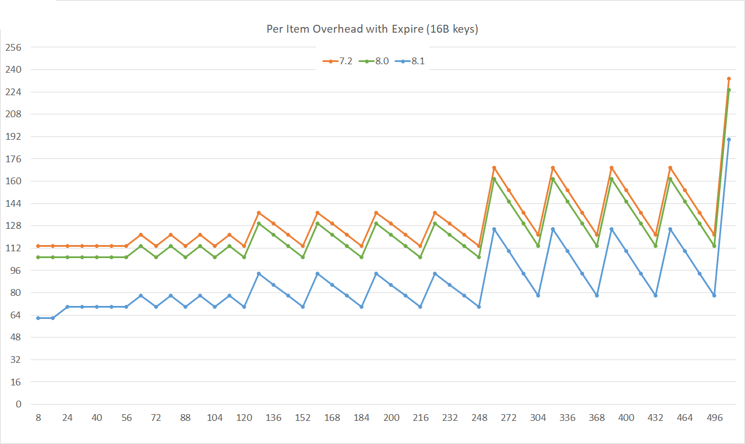
A new hash table
Notes:
These lines compare the actual memory usage between 8.1, 8.0, and 7.2. You can see that 8 byte drop we talked about earlier, compared to up to 32 bytes you can see when using expires. (We have two hash tables, one for the expiration information and one for the actual data). In the real world you won’t see this big of an improvement, but it’s a big improvement for some workloads.

Slide 27
Performance
Notes:
Now there is a lot of other exciting features in Valkey 8.0, but that release is old news now. So let’s talk about our most recent launch, Valkey 8.1.

Slide 28
Thread scalable command processing
Main Thread
System Epoll
Read Client Command
Parse Command
Execute Command
Send response
Notes:
One big piller was memory efficiency. We noticed there are a lot of pointer chasing in the Valkey implementation of the hash table, the core data structure. We were able to optimize this by embedding data in flexible memory allocations. This can save up to 8 bytes.

Slide 29
Thread scalable command processing
Main Thread
IO Thread 1
System Epoll
Read Client Command
Parse Command
Execute Command
Send response
Notes:
One big piller was memory efficiency. We noticed there are a lot of pointer chasing in the Valkey implementation of the hash table, the core data structure. We were able to optimize this by embedding data in flexible memory allocations. This can save up to 8 bytes.

Slide 30
Thread scalable command processing
Main Thread
IO Thread 1
System Epoll
Read Client Command
Execute Command
Parse Command
Execute Command
Send response
Read Client Command
Read Client Command
Parse Command
Parse Command
Send response
Send response
Notes:
One big piller was memory efficiency. We noticed there are a lot of pointer chasing in the Valkey implementation of the hash table, the core data structure. We were able to optimize this by embedding data in flexible memory allocations. This can save up to 8 bytes.

Slide 31
Thread scalable command processing
Main Thread
IO Thread 1
IO Thread 2
System Epoll
Read Client Command
Execute Command
Parse Command
Execute Command
Send response
Read Client Command
Read Client Command
Parse Command
Parse Command
Send response
Send response
Notes:
One big piller was memory efficiency. We noticed there are a lot of pointer chasing in the Valkey implementation of the hash table, the core data structure. We were able to optimize this by embedding data in flexible memory allocations. This can save up to 8 bytes.

Slide 32
Thread scalable command processing
Main Thread
IO Thread 1
IO Thread 2
Execute Command
System Epoll
Read Client Command
Execute Command
Read Client Command
Parse Command
Execute Command
Parse Command
Send response
Execute Command
Send response
Read Client Command
Execute Command
Read Client Command
Parse Command
Execute Command
Parse Command
Send response
Notes:
One big piller was memory efficiency. We noticed there are a lot of pointer chasing in the Valkey implementation of the hash table, the core data structure. We were able to optimize this by embedding data in flexible memory allocations. This can save up to 8 bytes.

Slide 33
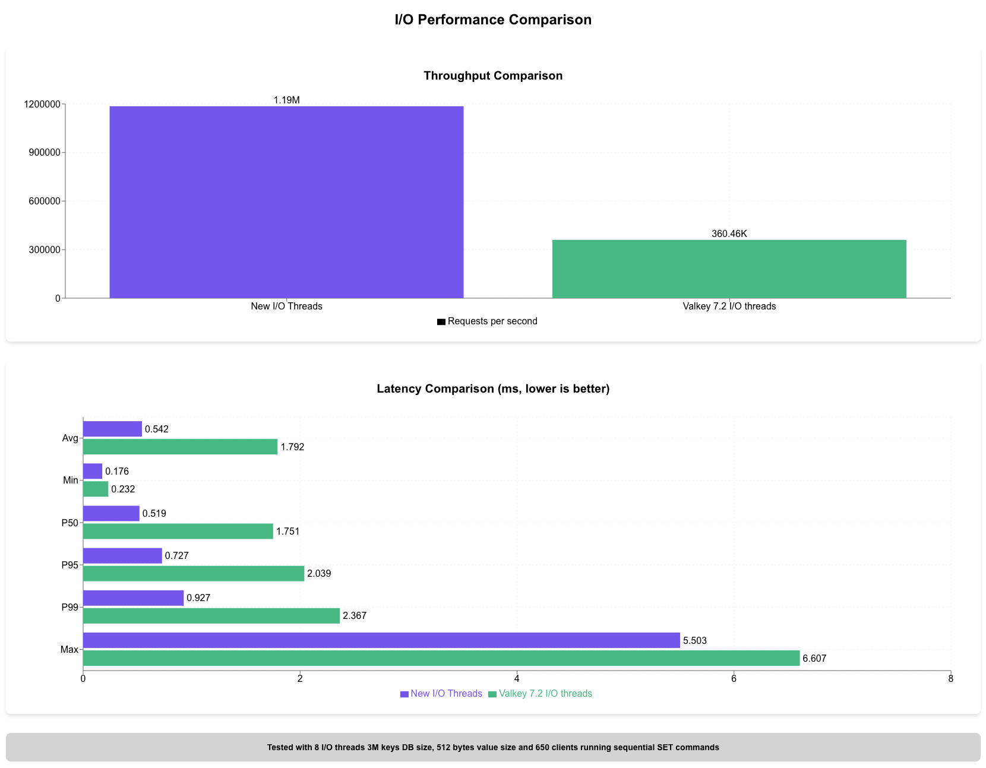
Multithreaded performance
Notes:
A 3x overall improvement in throughput compared to the previous version at similar or better latencies. This is a great way to better utilize multi-core machines in order to minimize the latency of your application.

Slide 41
Three queries, one answer
"GET user:1001:session"
"HGETALL user:1001:profile"
"TTL user:1001:session"
Different commands. Same connection pool.
Valkey GLIDE manages connections, retries, and cluster routing so your code doesn't have to.

Slide 42
Standalone vs. Cluster mode
Standalone
Cluster mode
Simple & fast
Scale & resilience
Single node, no sharding overhead.
Best for caching, sessions, and low-traffic workloads.
Automatic sharding across nodes.
Higher throughput, built-in failover. More operational complexity.
Start standalone. Move to cluster when you outgrow one node.

Slide 43
Standalone vs. Cluster mode
Standalone
Cluster
When simplicity is the priority.
Microsecond latency
Single node, no network hops between shards
Simple operations
No cluster topology to manage
Vertical scaling
Scale up RAM and CPU on one machine
Best for
Caching, sessions, rate limiting, queues
When scale and availability matter.
Horizontal scaling
Add nodes to grow beyond single-machine limits
High availability
Automatic failover with replica promotion
Data sharding
Keys distributed across slots automatically
Best for
Large datasets, high throughput, production workloads

